Slide 1
SEO Audit & Optimization for Organic Traffic Growth
Ramya Raghavan
Capstone Project –V
MB28

Slide 2
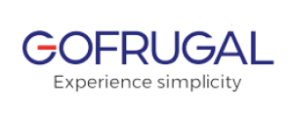
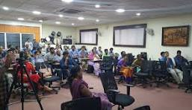
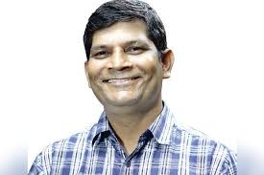
Introduction-GoFrugal
GoFrugal.com is the online platform for GoFrugal Technologies, a leading provider of innovative software solutions for businesses. The site offers a range of products, including enterprise resource planning (ERP), supply chain management, and business intelligence tools, designed to enhance operational efficiency and drive growth across various industries. With a focus on customer-centric solutions and cutting-edge technology, GoFrugal.com aims to empower organizations to optimize their processes and achieve their business objectives.
Kumar Vembu, CEO of Go Frugal
Under the leadership of Kumar Vembu, Go Frugal has prioritized the development of innovative software solutions aimed at enhancing efficiency and fostering growth for businesses across diverse sectors. His vision and commitment have positioned the company as a leader in delivering impactful technology that meets the evolving needs of the marketplace.

Slide 3

Project Objective
This project is designed to evaluate and address existing SEO challenges, implement industry best practices, and enhance the website's visibility and search engine rankings to facilitate business growth and improve its online presence.We will conduct a comprehensive SEO audit and implement optimization strategies aimed at:
Increasing organic traffic
Elevating search engine rankings
Strengthening overall online visibility
Through these efforts, we aim to create a more robust and effective digital presence for the organization.

Slide 4
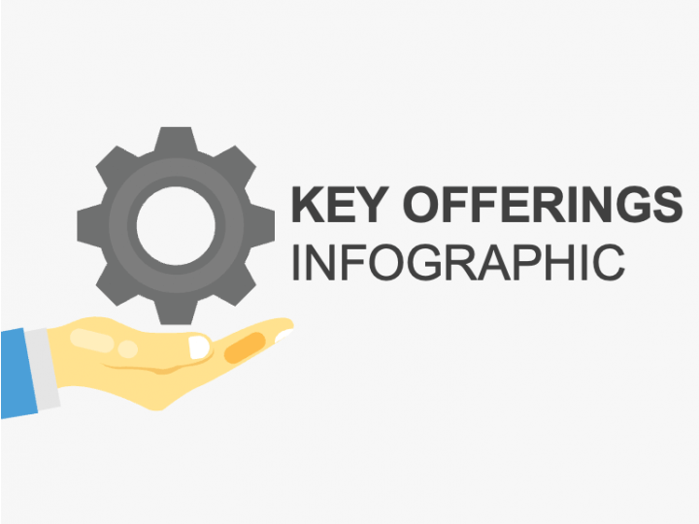
GoFrugal’s Key Offerings
Enterprise Resource Planning (ERP)
Retail Management
Manufacturing Solutions
Business Intelligence
Franchise Management
Supply Chain Management
Food and Beverage Management

Slide 5
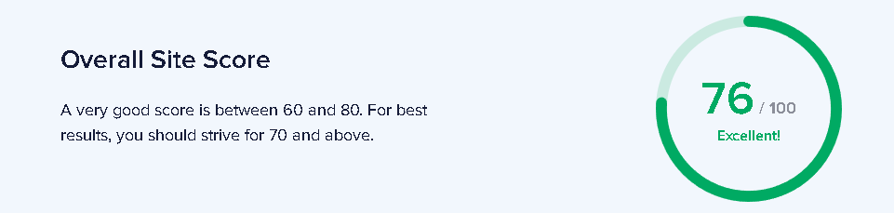
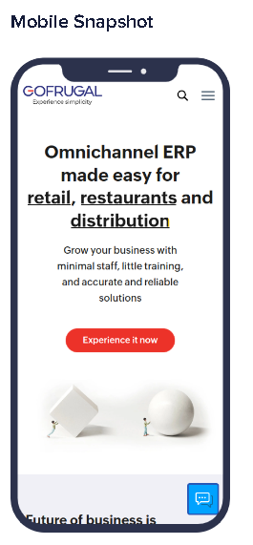
Initial Audit – Task 1

Slide 6

Initial Audit – Task 1
Strength
Title Optimization
The SEO title is well-optimized and includes relevant keywords with 73 Characteristics.
Gofrugal | ERP Software for Retail, Restaurant, & Distribution Industries
Keywords in Title and Description
Incorporating the same keywords in both the title and meta description reflects effective optimization practices. This consistency enhances clarity regarding the page's focus, thereby facilitating search engines' ability to recognize and accurately rank the content. Such alignment not only improves search visibility but also increases the likelihood of attracting relevant traffic by clearly conveying the page's intent to users.
Title: gofrugal, erp, software Description: erp, gofrugal

Slide 7
Initial Audit – Task 1
H1 and H2 Tags
The H1 tag effectively emphasizes "Omnichannel ERP" solutions tailored for specific industries. Its relevance aids both users and search engines in understanding the primary topic of the page. Furthermore, the inclusion of key keywords within the H1 tag enhances search engine optimization (SEO), improving the page's visibility and relevance in search results.
The H2 tags are strategically optimized, contributing to an improved content structure and readability. By segmenting the text into manageable sections, these tags enhance both search engine optimization (SEO) and the overall user experience, facilitating easier navigation throughout the content.

Slide 8
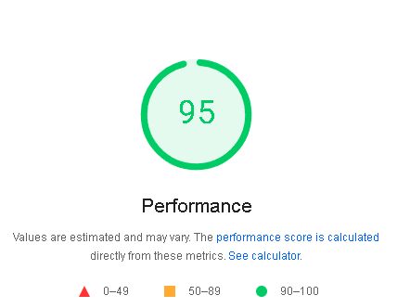
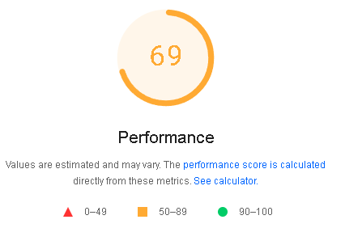
Initial Audit – Task 1
Current Performance - Desktop and Mobile
The website delivers outstanding performance on desktop, featuring quick load times and a seamless user experience. This high level of performance contributes to user retention and boosts visitor satisfaction on desktop devices.
The mobile performance score indicates considerable potential for improvement. A lower score can adversely affect user experience and SEO, especially with the rise in mobile traffic. Enhancing mobile performance is crucial for ensuring a better experience across all devices

Slide 9
Initial Audit – Task 1
Weakness and Recommended Solutions
Meta Description length
Current meta description is 269 characters, exceeding the 150-160 character limit.
Shorten it to ensure it fits within this range to avoid truncation in search results, improving its effectiveness in attracting clicks.
Missing Alt Attributes
Nine images lack alt attributes, which are crucial for accessibility and SEO.
Add descriptive alt attributes to improve search engine visibility and enhance user experience.
Internal linking
There are only 9 internal links versus 38 external links.
Increasing internal links can enhance site navigation, distribute page authority, and boost overall SEO. Connect related content for better results.
Open Graph Meta tags
Some Open Graph meta tags are missing, which affects how content appears on social media.
Implement these tags to improve integration and visibility when sharing.

Slide 10

Initial Audit – Task 1
SEO Strategy Recommendations:
Leverage Strengths:
Maintain well-optimized SEO titles and H1 tags.
Enhance Mobile Performance:
Optimize site for better mobile responsiveness and speed.
Optimize Meta Descriptions:
Shorten and refine meta descriptions for improved click-through rates.
Add Missing Alt Attributes:
Implement descriptive alt attributes for all images to enhance accessibility and SEO.
Improve Internal Linking:
Increase internal links to connect related content and distribute page authority effectively.
Addressing these areas will significantly enhance user experience and boost search engine rankings.

Slide 11
Keyword Research – Task 2
Short Tail keywords
ERP Software
Cloud ERP
Point of Sale Software
ERP Software: High search volume; targets businesses looking for comprehensive solutions. High competition.
Cloud ERP: Increasingly popular as businesses move to cloud solutions. Good opportunity, particularly with growing cloud adoption.
Point of Sale Software: Essential for retail and all types of sectors. High search volume; competition from established players.
Overall Insights:
Competition: Most short-tail keywords are highly competitive, so ranking can be challenging.
Relevance: Ensure that the content is specifically tailored to the keyword to improve conversion rates.
Strategy: Pair these keywords with long-tail variations to attract more qualified traffic and improve SEO effectiveness.

Slide 12
Keyword Research – Task 2
Short Tail keywords
ERP Software
Cloud ERP
Point of Sale software
Search volume data from https://backlinko.com/tools/keyword

Slide 13
Keyword Research – Task 2
Long Tail keywords
Best ERP software for small businesses
Cloud based ERP System
Supply chain Management Software
Overall Insights:
Relevance: Each keyword aligns closely with specific user needs, enhancing the likelihood of conversion.
Competition: While long-tail keywords typically have lower competition, some may still face challenges from niche players.
Content Strategy: Leveraging these keywords can support targeted content creation, boosting SEO and user engagement.
Best ERP software for small businesses:
Search Intent: Users seeking solutions tailored for small enterprises.
Pros: Targets a specific audience, likely high conversion potential.
Cons: May have moderate competition from other ERP providers.
Cloud based ERP Systems
Search Intent: Manufacturers looking for cloud solutions.
Pros: Growing trend towards cloud computing; can position GoFrugal
effectively.
Cons: Competition from established cloud ERP providers.
Supply chain Management Software
Search Intent: Logistics companies seeking supply chain solutions.
Pros: Targets a specific sector; can lead to strong engagement.
Cons: Competition from specialized logistics software.

Slide 14
Keyword Research – Task 2
Long Tail keywords
Best ERP software for small businesses
Cloud based ERP System
Supply chain Management Software
Search volume data from https://backlinko.com/tools/keyword

Slide 15
Keyword Research – Task 2
Transactional keywords
Purchase inventory management system
Order retail management software
Best POS Software for Restaurants
Purchase Inventory Management system:
Appeals to businesses seeking to streamline their inventory processes with a reliable management system.
Retail Order management software
Attracts retailers looking for software solutions to enhance their management and operational efficiency.
Best POS Software for Restaurants.
Focuses on restaurant owners looking for user-friendly point-of-sale systems to improve transaction handling.
These descriptions help clarify the intent behind each keyword, highlighting their relevance to potential customers looking to make informed purchasing decisions.

Slide 16
Keyword Research – Task 2
Transactional keywords
Purchase inventory management system
Order retail management software
Best POS software for restaurants
Search volume data from https://backlinko.com/tools/keyword

Slide 17
Keyword Research – Task 2
Competitor Strategies
Keyword Optimization
Competitors focus on long-tail keywords to capture specific search intents, enhancing visibility in niche markets.
Content Marketing
Use of blogs, case studies, and whitepapers to educate potential customers and establish authority.
User-Centric Design
Emphasis on intuitive user interfaces and seamless integration, appealing to both small and large enterprises.
Targeted Campaigns
Tailoring marketing campaigns to specific industries (e.g., retail, manufacturing) to address unique pain points.
Customer Testimonials
Leveraging positive feedback to build trust and credibility in the market.
Opportunity for GoFrugal
Identify underserved keywords and create targeted content that addresses gaps in competitor offerings, enhancing visibility and attracting relevant traffic.
Competitor Keywords
ERP Software for Small Businesses
Cloud-Based ERP Solutions
Retail Management Software
Inventory Management System
Business Analytics Software
Point of Sale (POS) Systems
Supply Chain Management Software
Manufacturing ERP Software
Billing and Invoicing Software
Custom ERP Solutions

Slide 18
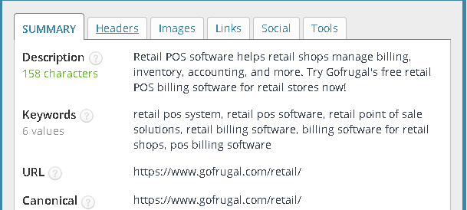
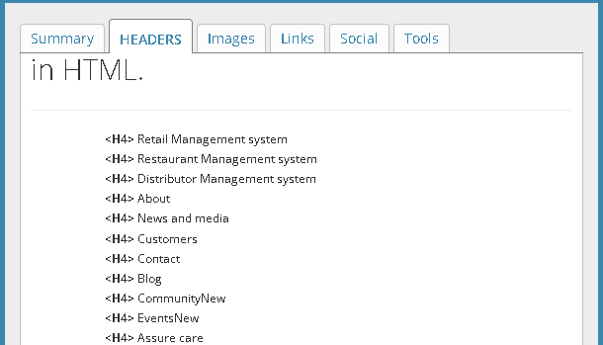
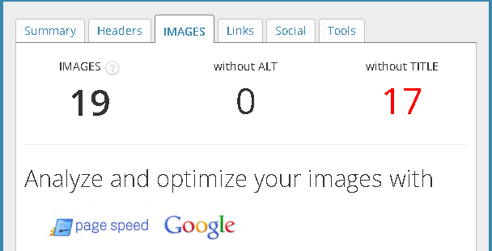
On-Page SEO Optimization Audit – Task 3
Audit Page :https://www.gofrugal.com/retail/
Keyword : Retail POS Software
Title & Meta Description
The title and meta description are effectively optimized with the target keyword "Retail POS Software." They align with search engine requirements, ensuring relevance to user queries and improving click-through rates.
Headers
The headers are well-structured and appropriately used throughout the content. This organization aids in enhancing readability and user experience by breaking down the information effectively, making it easier for readers to navigate and understand the material.

Slide 19
On-Page SEO Optimization Audit – Task 3
Audit Page :https://www.gofrugal.com/retail/
Keyword : Retail POS Software
Positive Aspects:
Effective Internal Linking:
The internal linking structure is well-optimized, enhancing navigation and related content discovery.
This practice distributes page authority, benefiting overall SEO performance.
Optimized Image Use:
Images include relevant ALT tags and descriptive filenames.
This improves accessibility for users with visual impairments and boosts search engine visibility.
Areas for Improvement:
Keyword Usage Concerns:
The target keyword "Retail POS Software" is used 6 times in the content.
This overuse constitutes keyword stuffing, which can harm both search engine rankings and user experience.
Recommendation:
Distribute the keyword more naturally to enhance readability and optimize SEO.

Slide 20
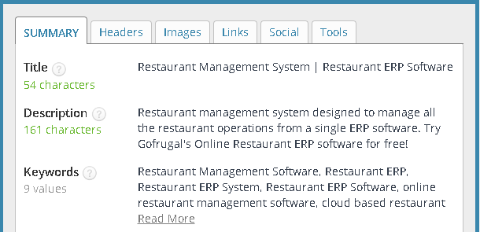
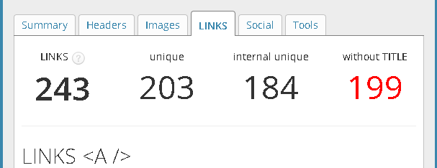
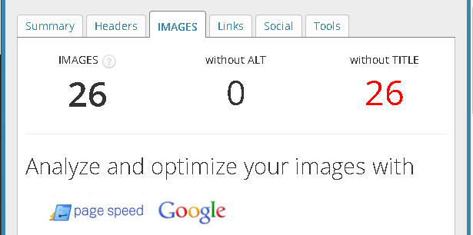
On-Page SEO Optimization Audit – Task 3
Audit Page :https://www.gofrugal.com/restaurant/
Keyword :Restaurant ERP Software
Keyword Utilization Insights
Observation: The keyword "Restaurant Management System" appears 9 times in the content.
Issue: This overuse constitutes keyword stuffing, which can negatively impact search engine rankings and user experience. It may lead to penalties and reduce readability, making the content less engaging.
Internal Linking Effectiveness
Observation: Internal links are well-optimized.
Details: Effective internal linking enhances site navigation, distributes page authority, and improves overall user experience. It helps users easily find related content and supports SEO by establishing a clear site structure.
Image Accessibility
Observation: Images are optimized with descriptive ALT tags.
Details: Properly optimized images enhance accessibility for visually impaired users and contribute to better search engine rankings by providing context for the image content.

Slide 21
On-Page SEO Optimization Audit – Task 3
Keyword Strategy Suggestions
Balance Keyword Density
Reduce the frequency of the target keyword to avoid stuffing. Focus on integrating the keyword naturally within the content to maintain readability and enhance the user experience.
Incorporate Variations
Use synonyms and related terms to diversify keyword usage. This enriches the content without overloading on the primary keyword.
Strengths to Preserve
Internal Linking
Continue to leverage internal links to enhance site navigation and improve SEO performance. Ensure that all links are relevant and add value for the user.
Image Optimization
Maintain the practice of optimizing images with descriptive ALT tags and filenames. Regularly review and update images to ensure they remain relevant and effective.
Title Enhancement
Refine the Title
Adjust the title to better reflect the content while incorporating keywords more naturally. Ensure it is engaging and accurately represents the information, which can improve search visibility and user engagement.
Recommendations for Keyword Optimization
Limit Keyword Frequency
Reduce the number of times the keyword appears for better readability.
Incorporate Variants
Use synonyms and related terms (e.g., "Restaurant ERP software") to diversify usage.
Emphasize Quality Content
Focus on creating high-quality, informative content that naturally includes target keywords.

Slide 22
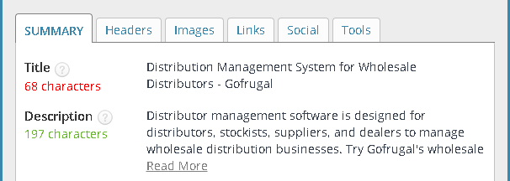
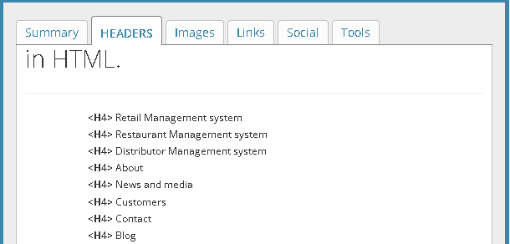
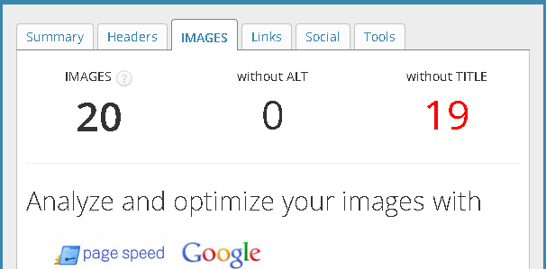
On-Page SEO Optimization Audit – Task 3
Audit Page :https://www.gofrugal.com/distribution/
Keyword : Distribution Management Software
Title & Meta Description Analysis
The title and meta description are well-optimized with the target keyword "Distribution management software," but there's an issue with over-optimization due to excessive repetition.
Header Optimization
Strengths
Internal Links
Well-optimized internal links enhance site navigation and positively impact SEO, making it easier for users to find related content and improving website structure.
Image Optimization
Images are optimized with descriptive ALT tags and filenames, enhancing accessibility for visually impaired users and improving search visibility by providing context to search engines.

Slide 23
On-Page SEO Optimization Audit – Task 3
Weaknesses Identified
Keyword Stuffing
The target keyword "Distribution management software" appears excessively (10 times) throughout the content. This overuse leads to keyword stuffing, which can negatively impact search rankings and reduce readability. Search engines may penalize content perceived as spams or artificially optimized.
Title Optimization Issues
The title does not accurately reflect the content or incorporate necessary keywords in a balanced way. Enhancing the title could better align with search engine best practices and improve click-through rates.
Recommendations for Enhancement
Limit Keyword Usage
Decrease the frequency of the target keyword for improved readability.
Incorporate Synonyms
Use related terms to diversify and enrich keyword presence.
Adjust Title
Revise the title to better match the content and keywords effectively.
Emphasize Quality Content
Focus on creating engaging, informative content that naturally integrates keywords.

Slide 24
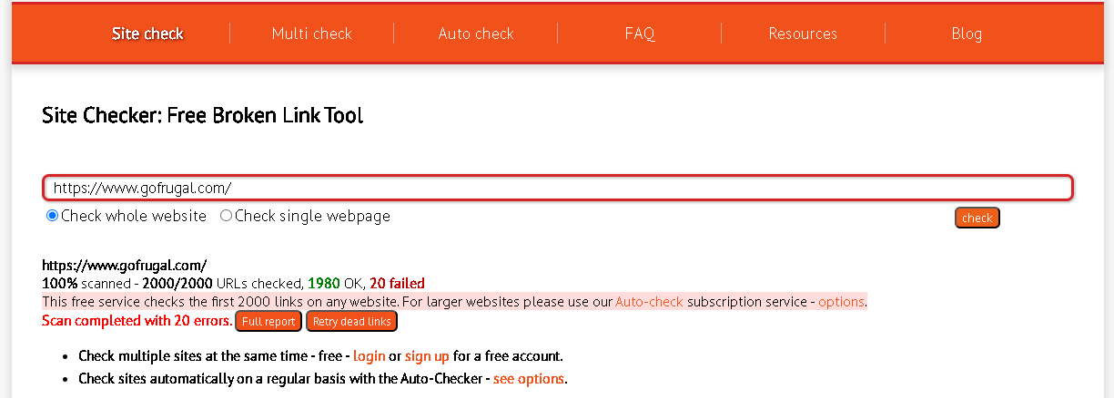
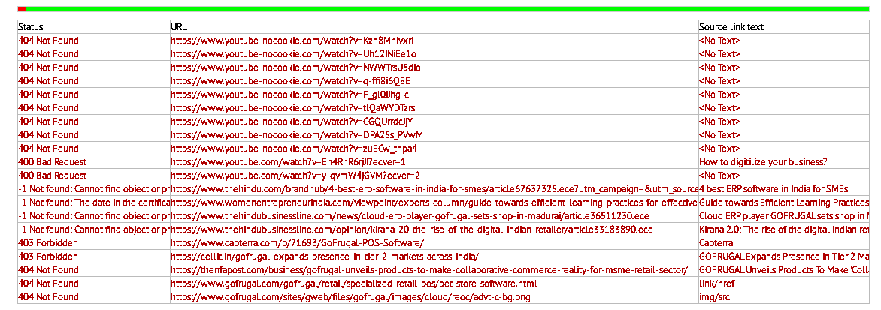
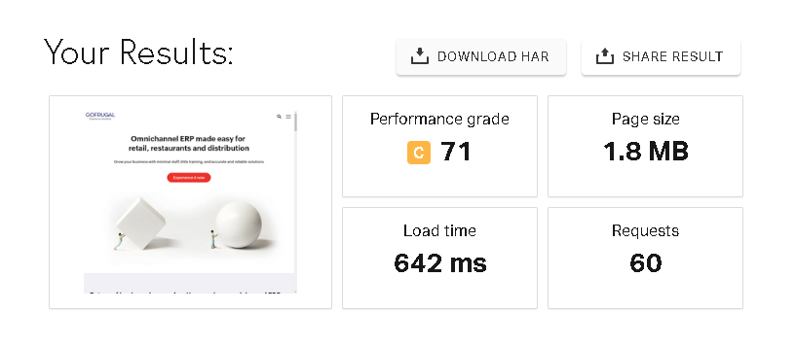
Technical SEO : Task 4
Broken Links
Issue Identified: During our analysis, we discovered 20 broken links on the site. While the majority of these broken links direct to YouTube videos and external article content, the implications of having these links remain significant.
Impact: Broken links result in 404 errors, which can severely diminish user experience by preventing visitors from accessing the intended content. This not only frustrates users but can also lead to higher bounce rates, as they may leave the site in search of the information they need elsewhere.
From an SEO perspective, broken links can waste crawl budget, limiting the number of pages search engines can index. When search engines find multiple broken links, it hinders their ability to discover valuable content. Additionally, a high number of broken links can diminish your site’s authority and trustworthiness, potentially impacting overall rankings.

Slide 25
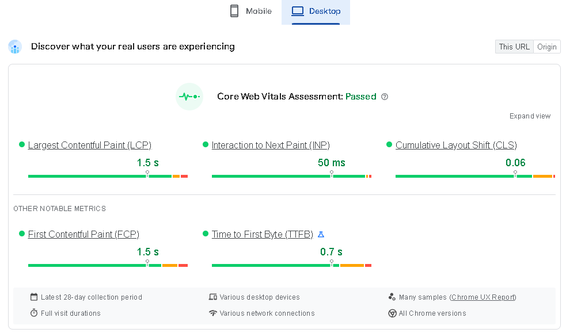
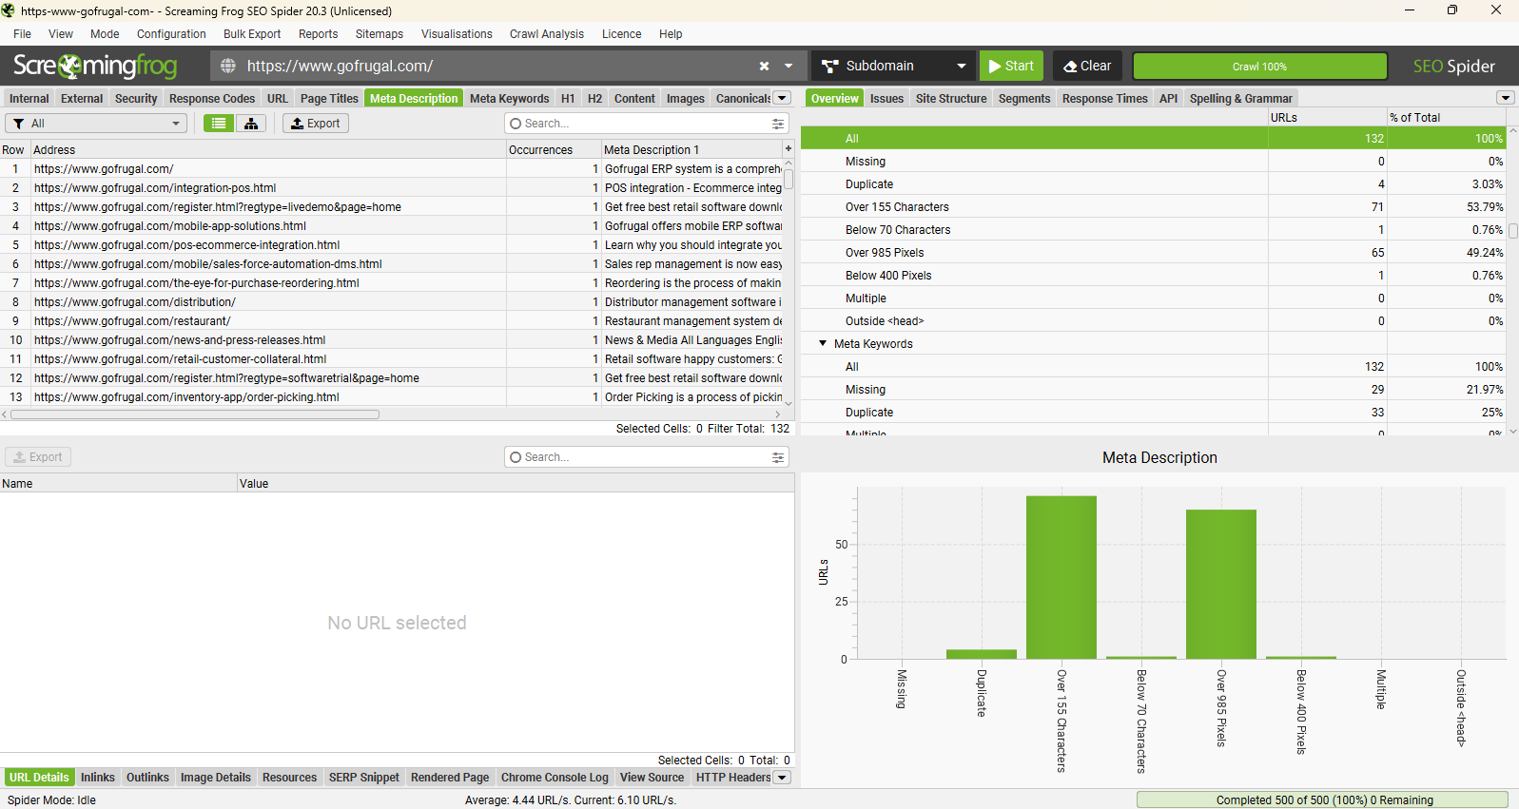
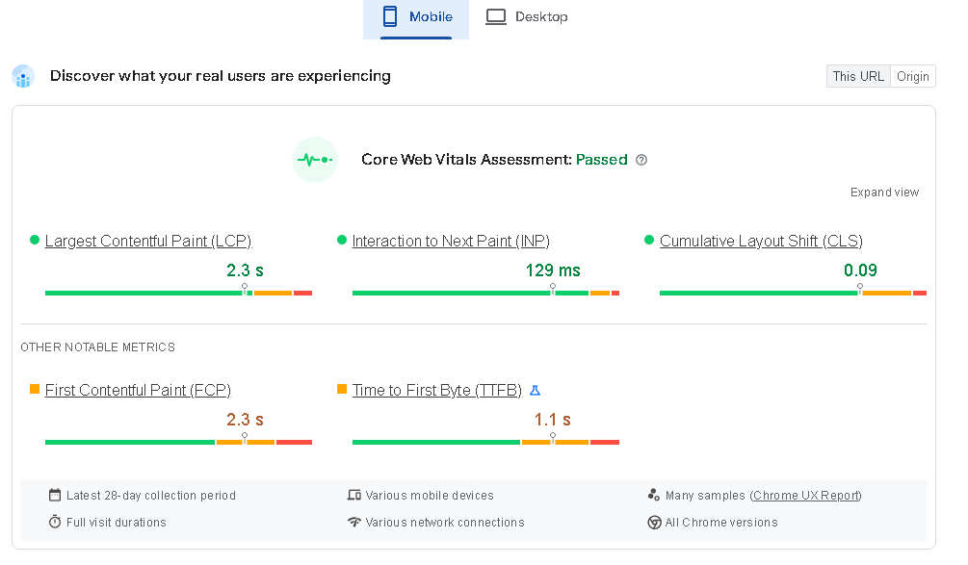
Technical SEO : Task 4
Duplicate Links
Issue Identified: Four duplicate links detected on the site.
Impact: Duplicate links can create confusion for both users and search engines, weaken link authority, and hinder proper indexing.

Slide 26

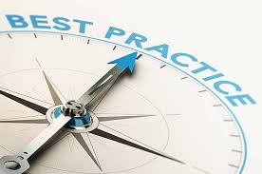
Technical SEO : Task 4
Improving site and web page speed is essential for enhancing user experience and boosting SEO rankings. Here are five key practices to achieve faster loading times:
Image and Media Optimization
Compression: Use formats like WebP for efficient compression of images and videos.
Responsive Images: Deliver images sized for the user's device and screen resolution.
Lazy Loading: Load media only when in the viewport to speed up initial load times.
Reduce HTTP Requests
Combine Files: Merge CSS and JS files to cut down on requests.
CSS Sprites: Combine multiple images into one sprite sheet to minimize requests.
Enhance Browser Caching
Cache-Control Headers: Set headers to enable efficient caching of resources.
Expiration Dates: Define long expiration dates for static files to extend caching duration.
Minify and Compress Code
Minification: Strip out unnecessary characters from HTML, CSS, and JS.
Gzip/Brotli Compression: Enable server-side compression to reduce file sizes.
Optimize Hosting Configuration
Content Delivery Network (CDN): Utilize a CDN for global content distribution, improving load times.
Server Response Time: Select a reliable hosting provider and optimize server settings, using HTTP/2 for enhanced performance.
Implementing these strategies can significantly boost your website's speed, improving user experience and search engine rankings.

Slide 27
Content Strategy – Task 5
1.Objectives
Enhance organic search visibility for targeted keywords.
Increase website traffic and improve user engagement.
Generate qualified leads through optimized content.
2. Keyword Research
Conduct comprehensive keyword research to identify primary and long-tail keywords relevant to the retail and ERP software industry. Analyze competitor keywords and search trends to uncover opportunities.
3. Content Development
Blog Posts: Create informative articles targeting specific keywords and addressing audience pain points. Topics could include "Benefits of Retail POS Software" and "How to Choose an ERP System.“
Guides and Resources: Develop comprehensive guides and e-books that can be gated for lead generation (e.g., "Ultimate Guide to Distribution Management Software").
Case Studies: Showcase successful implementations to build credibility and attract potential customers.
FAQs: Develop a FAQ section addressing common queries related to your products and services, optimizing for voice search and featured snippets.

Slide 28
Content Strategy – Task 5
4.On-Page SEO Optimization
Optimize title tags, meta descriptions, headers, and content for targeted keywords.
Use internal linking to connect related articles and enhance site structure. Ensure all images have descriptive ALT tags and filenames for better search engine indexing.
5. Content Calendar
Create a content calendar with a mix of content types and publication frequency (e.g., weekly blog posts, monthly guides).
Include seasonal topics or industry events to keep content relevant.
6. Promotion and Link Building
Share content across social media platforms and relevant online communities. Engage in outreach to industry influencers and bloggers for guest posting and backlink opportunities. Utilize email marketing to distribute content and drive traffic to the site.
7. Analytics and Performance Tracking
Use tools like Google Analytics and Google Search Console to monitor traffic, user behavior, and keyword rankings.
Track KPIs such as organic traffic growth, bounce rates, and conversions to measure success.
8. Continuous Optimization
Regularly review and update existing content to keep it fresh and relevant. Adjust the strategy based on performance data and emerging SEO trends.

Slide 29
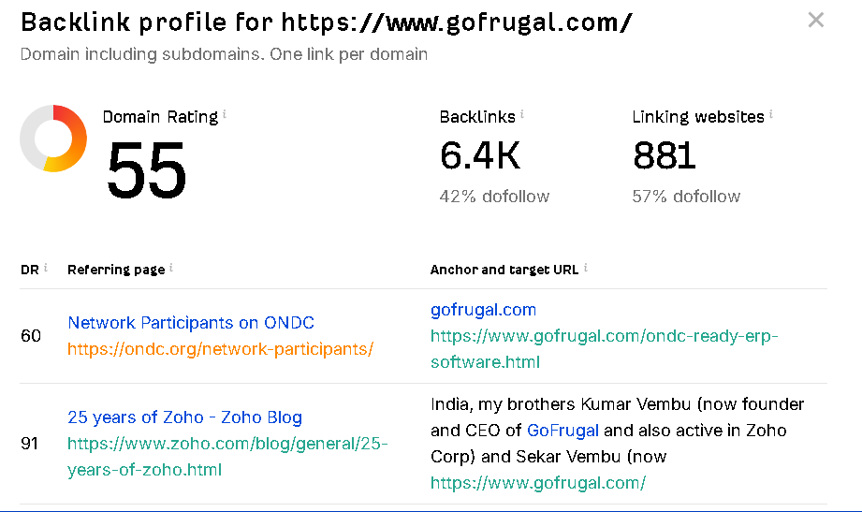
Off Page SEO – Task 6

Slide 30

Off Page SEO – Task 6
Back Link - Summary
The website boasts high-quality backlinks from authoritative and relevant sources.
The anchor text utilized in these backlinks is both relevant and diverse.
A total of 6,400 backlinks have been identified, with 42% classified as "do follow," contributing positively to the destination site's search rankings.
There are 881 linking domains, with 42% of them being "do follow" links.
The overall domain rating for these backlinks is 55, indicating a strong performance.

Slide 31

Summary
Better SEO Rankings
GoFrugal's website achieved better rankings for targeted keywords, resulting in increased organic traffic and greater visibility in search engine results.
Boosted Organic Visitors
Effective SEO strategies have significantly raised site traffic, enhancing user engagement with lower bounce rates and longer session durations.
Amplified Online Engagement
High-quality backlinks and active engagement on social media have bolstered GoFrugal's authority, credibility, and brand recognition.
Elevated User Engagement
Improvements in site speed and content relevance have led to higher user satisfaction, resulting in better retention and more qualified leads.
Regional and Industry Visibility
Consistent local citations and successful outreach efforts have established GoFrugal as a leading thought leader in the business software industry.

Slide 32

Conclusion
The SEO project significantly boosted GoFrugal’s online visibility, traffic, and user engagement.
Through the implementation of a comprehensive SEO strategy, GoFrugal achieved improved search rankings, solidified its industry presence, and enhanced user experience.
These efforts have positioned the company for sustained growth and a competitive edge in the market.

Slide 33


